Slide 1

Blinkit
Power BI Dashboard

Slide 2

* Introduction *
Blinkit is a leading online grocery delivery service in india, known for its lightening fast delivery times. Formerly known as Grofers, the company rebranded to reflect its commitment to delivering essentials in the blink of an eye.
Founded in 2013, Blinkit has revolutionzed the way people shop for groceries by offering a wide range of products, from fresh produce to household essentials, right at your doorstep.

Slide 3

Requirements
To conduct a comprehensive analysis of Blinkit’s sales performance, customer satisfaction and inverntory distribution to identify key insights and opportunities for optimization using various KPIs and visualizations in Power BI.
KPI’s Requirements :
Total Sales :- The Overall revenue generated from all items sold.
Average Sales :- The Average revenue per sale.
Number of Items :- The Total count of different items sold.
Average Rating :- The Average customer rating for items sold.

Slide 4

Visualization Requirements
Total sales by Fat Content
Total Sales by Item Type
Fat Content by Outlet for Total Sales
Sales by Outlet Size
Sales by Outlet Locations
All Metrics by Outlet Type

Slide 5
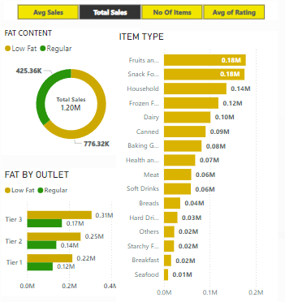
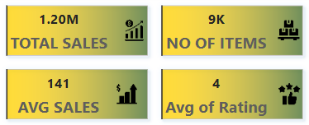
DashBoard

Slide 6
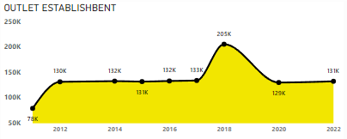
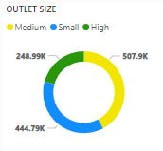
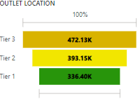
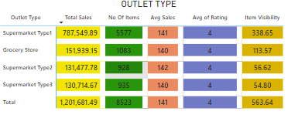


Slide 7
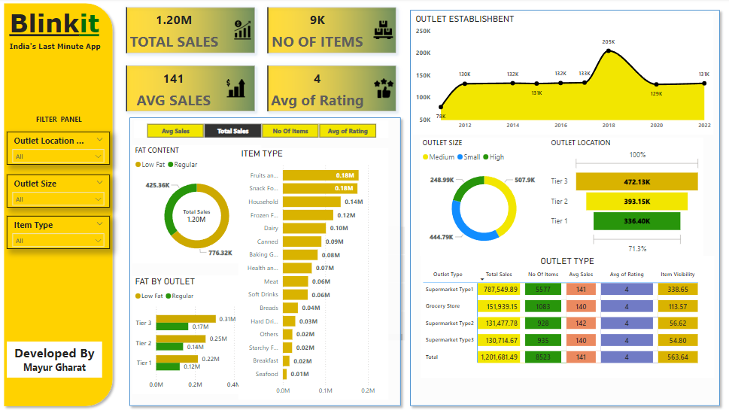

Slide 8


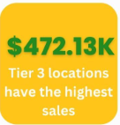

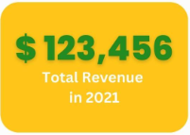
Findings
Total Sales : $ 1.20 M
Average Sales Per Item : $141
Number Of items : 8523
Average Rating : 3.9 out of 5

